Slide 1
Natural Language Processing Specialization Text Summarization with Transformers
(2021 Deeplearning.ai)
YangXi’s Reading Notes

Slide 2
Transformer vs RNN
RNN / vanilla Seq2Seq
You need to take sequential steps to encode your inputs, then take another set of sequential steps to decode the information
Little room for parallel computation – the longer input sentence, more time to process
Longer sequence – loss of information, vanishing gradients
LSTM and GRU help a little with these problems
Still fail on very long sentence because of information bottleneck
Seq2Seq with Attention
LSTM / GRU / vanilla RNN for encoder and decoder
Transformers: (2017, Google) Attention Is All You Need
Rely only on attention mechanisms
Do NOT require use of RNN
Easy to parallelize

Slide 3
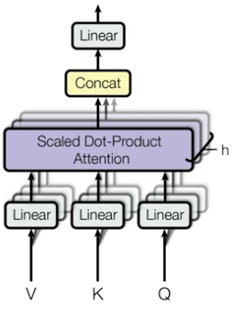
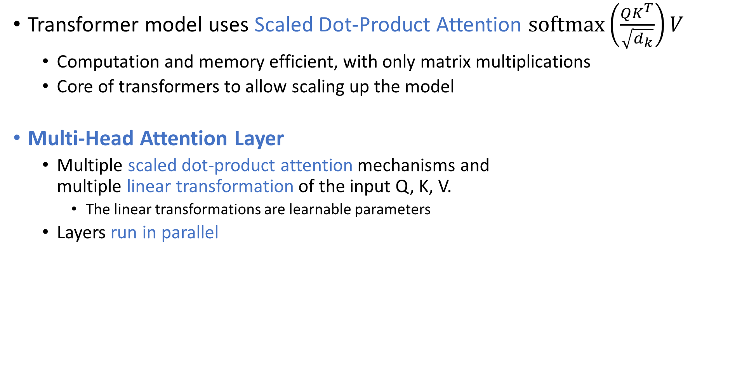
Transformers Overview
Transformer model uses Scaled Dot-Product Attention $softmax\left(\frac{QK^{T}}{\sqrt{d_{k}}}\right)V$
Computation and memory efficient, with only matrix multiplications
Core of transformers to allow scaling up the model
Multi-Head Attention Layer
Multiple scaled dot-product attention mechanisms and multiple linear transformation of the input Q, K, V.
The linear transformations are learnable parameters
Layers run in parallel

Slide 4
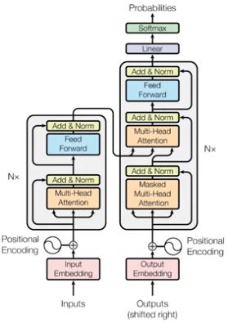
Transformers Overview
Encoder
A single encoder layer
Start with a multi-head attention module
Self-attention on the input sequence: each item in the input attends to every other item in the input
Provide contextual representation of each item in the input
Followed by a residual connection, normalization, a feed- forward layer, and another residual and normalization
Repeat the above encoder layer N times
Decoder
A single decoder layer
Start with a multi-head attention module, residual, normalization
Masked self-attention: each position attends only to previous positions
Block left-ward flowing information
The 2nd attention module is called Encoder-Decoder Attention
It takes the encoder outputs and allows the decoder to attend to all items
Every position from the decoder attends to the outputs from the encoder
Repeat the above decoder layer N times
Positional Encoding
Handle word order, as transformers do not use RNN
Positional encoding can be learnt or fixed, just as word embeddings
Simply embed the word position 0, 1, 2, 3, … up to a defined maximum K

Slide 5
Transformers – Names and Applications
State of the Art Transformers
GPT-2 (Generative Pre-training for Transformer) (2018, Open AI)
BERT (Bidirectional Encoder Representations from Transformers) (2018, Google)
T5 (Text-Text Transfer Transformer) (2019, Google)
A single T5 model can learn to do multiple different tasks
For example, you can train one model to do Translation, Classification, and Q&A at the same time
Then you input a “task” and the data, the model will output according to the task specified
T5 can also
Regression, such as measure similarity between 2 sentences
Summarization, such as representing a paragraph with a single sentence
Transformer has many applications
Text Summarization, Auto-Complete, Named Entity Recognition(NER), Question Answering (Q&A), Translation, Chat-Bots, and other tasks such as sentiment analysis, market intelligence, text classification, character recognition, spell checking

Slide 6
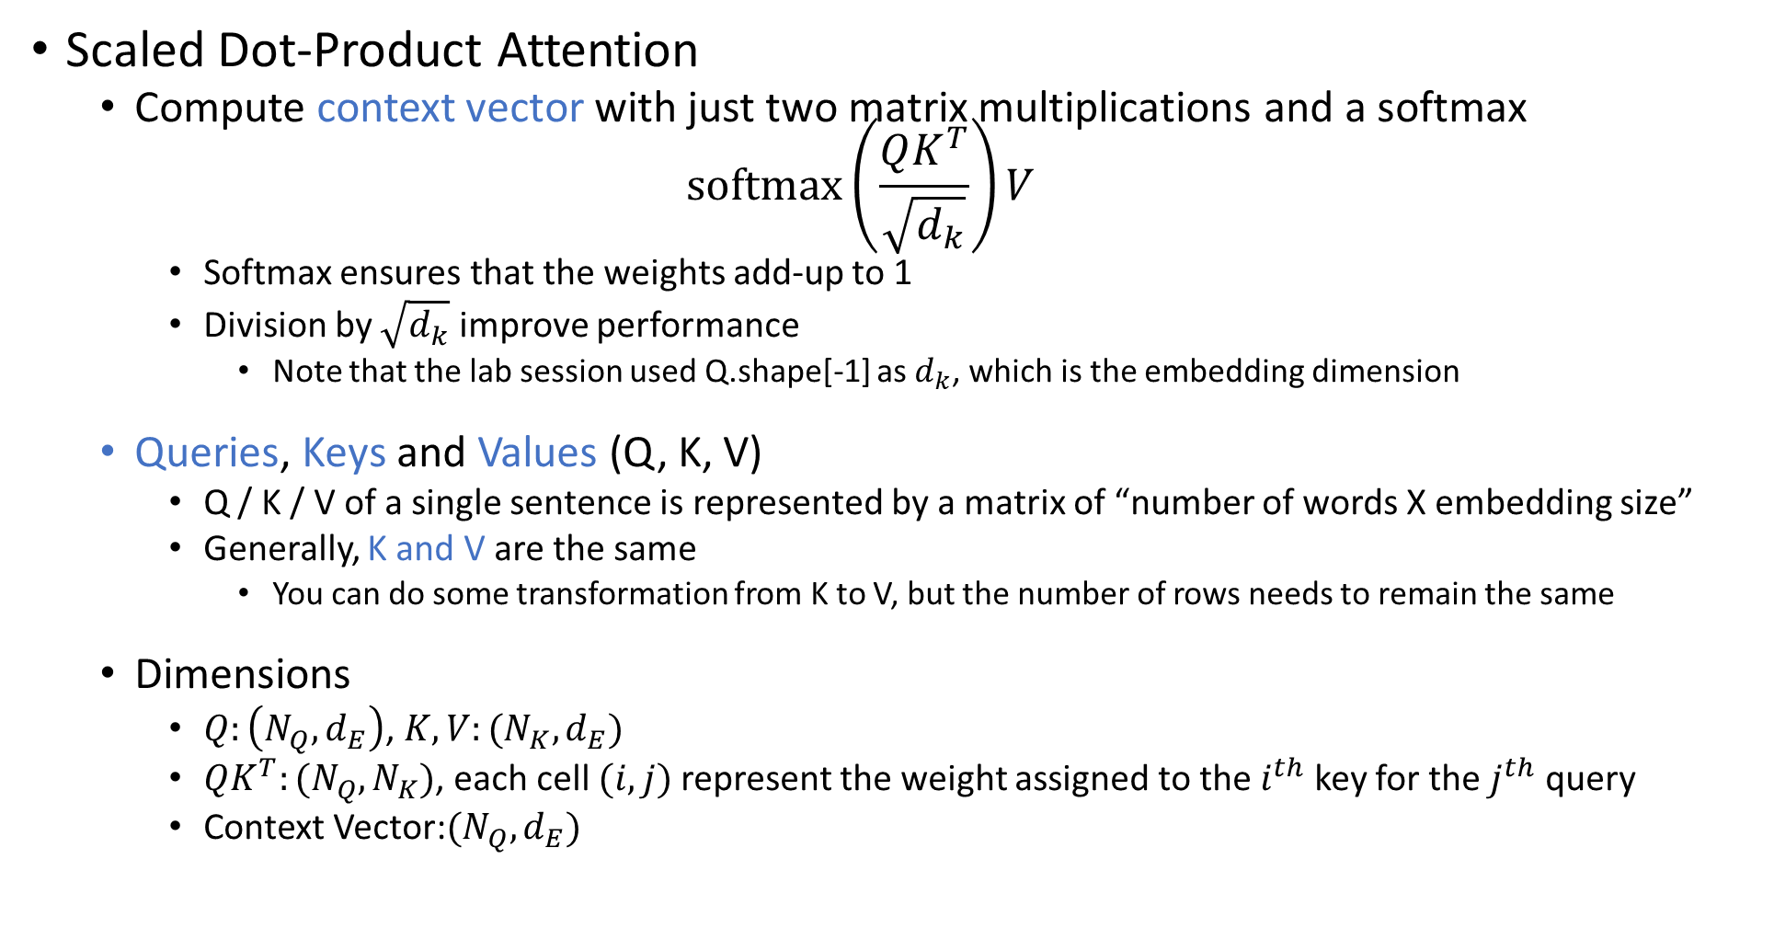
Scaled Dot-Product Attention
Scaled Dot-Product Attention
Compute context vector with just two matrix multiplications and a softmax $softmax\left(\frac{QK^{T}}{\sqrt{d_{k}}}\right)V$
Softmax ensures that the weights add-up to 1
Division by $\sqrt{d_{k}}$ improve performance
Note that the lab session used Q.shape[-1] as $d_{k}$, which is the embedding dimension
Queries, Keys and Values (Q, K, V)
Q / K / V of a single sentence is represented by a matrix of “number of words X embedding size”
Generally, K and V are the same
You can do some transformation from K to V, but the number of rows needs to remain the same
Dimensions
$Q:\left(N_{Q}, d_{E}\right)$, $K,V:(N_{K}, d_{E})$
$QK^{T}:(N_{Q},N_{K})$, each cell $(i,j)$ represent the weight assigned to the $i^{th}$ key for the $j^{th}$ query
Context Vector:$(N_{Q}, d_{E})$

Slide 7
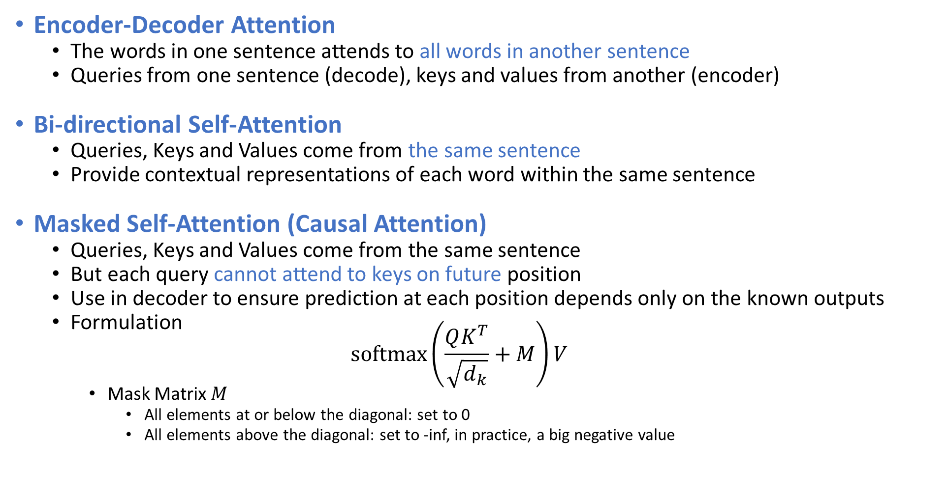
Three basic types of Attention
Encoder-Decoder Attention
The words in one sentence attends to all words in another sentence
Queries from one sentence (decode), keys and values from another (encoder)
Bi-directional Self-Attention
Queries, Keys and Values come from the same sentence
Provide contextual representations of each word within the same sentence
Masked Self-Attention (Causal Attention)
Queries, Keys and Values come from the same sentence
But each query cannot attend to keys on future position
Use in decoder to ensure prediction at each position depends only on the known outputs
Formulation $softmax\left(\frac{QK^{T}}{\sqrt{d_{k}}}+M\right)V$
Mask Matrix $M$
All elements at or below the diagonal: set to 0
All elements above the diagonal: set to -inf, in practice, a big negative value

Slide 8
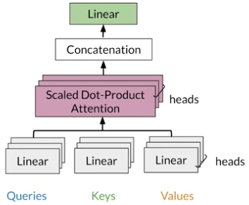
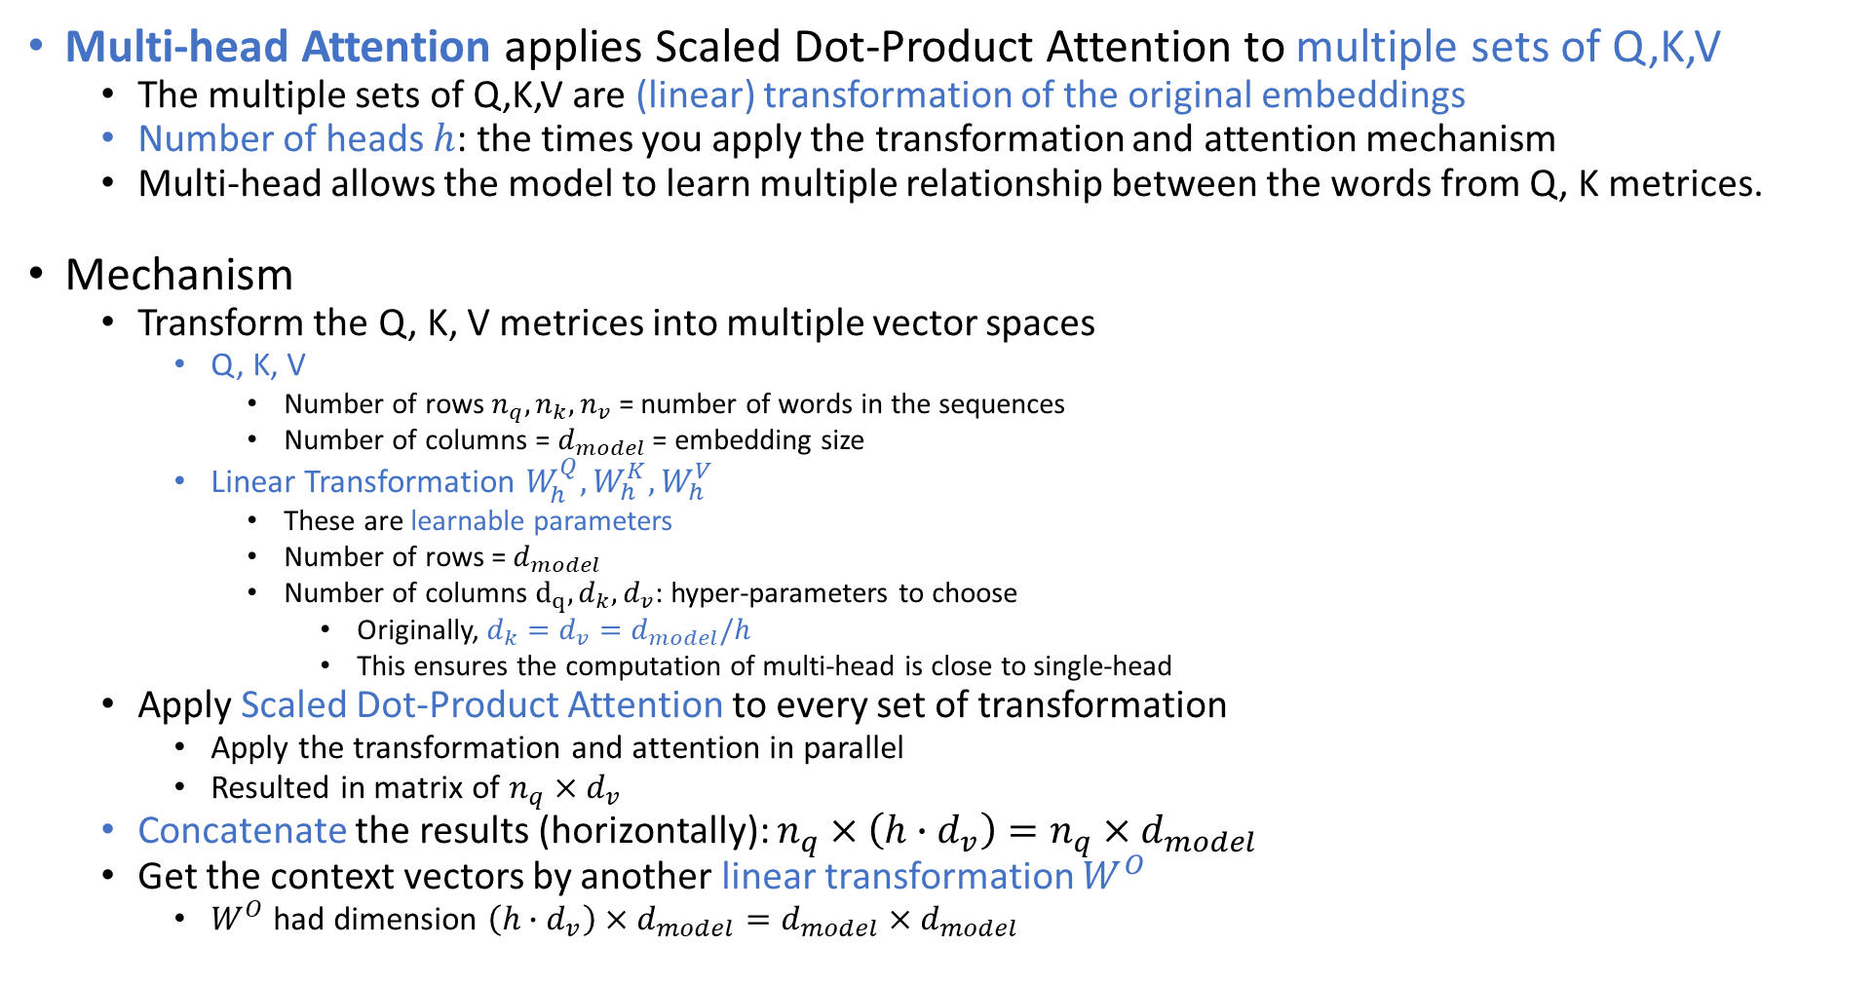
Multi-head Attention
Multi-head Attention applies Scaled Dot-Product Attention to multiple sets of Q,K,V
The multiple sets of Q,K,V are (linear) transformation of the original embeddings
Number of heads $h$: the times you apply the transformation and attention mechanism
Multi-head allows the model to learn multiple relationship between the words from Q, K metrices.
Mechanism
Transform the Q, K, V metrices into multiple vector spaces
Q, K, V
Number of rows $n_{q},n_{k},n_{v}$ = number of words in the sequences
Number of columns = $d_{model}$ = embedding size
Linear Transformation $W_{h}^{Q},W_{h}^{K},W_{h}^{V}$
These are learnable parameters
Number of rows = $d_{model}$
Number of columns $d_{q},d_{k},d_{v}$: hyper-parameters to choose
Originally, $d_{k}=d_{v}=d_{model}/h$
This ensures the computation of multi-head is close to single-head
Apply Scaled Dot-Product Attention to every set of transformation
Apply the transformation and attention in parallel
Resulted in matrix of $n_{q}×d_{v}$
Concatenate the results (horizontally): $n_{q}×\left(h∙d_{v}\right)=n_{q}×d_{model}$
Get the context vectors by another linear transformation $W^{O}$
$W^{O}$ had dimension $\left(h∙d_{v}\right)×d_{model}=d_{model}×d_{model}$

Slide 9
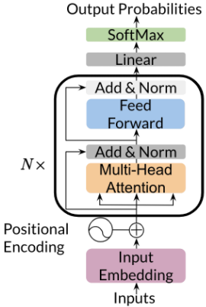
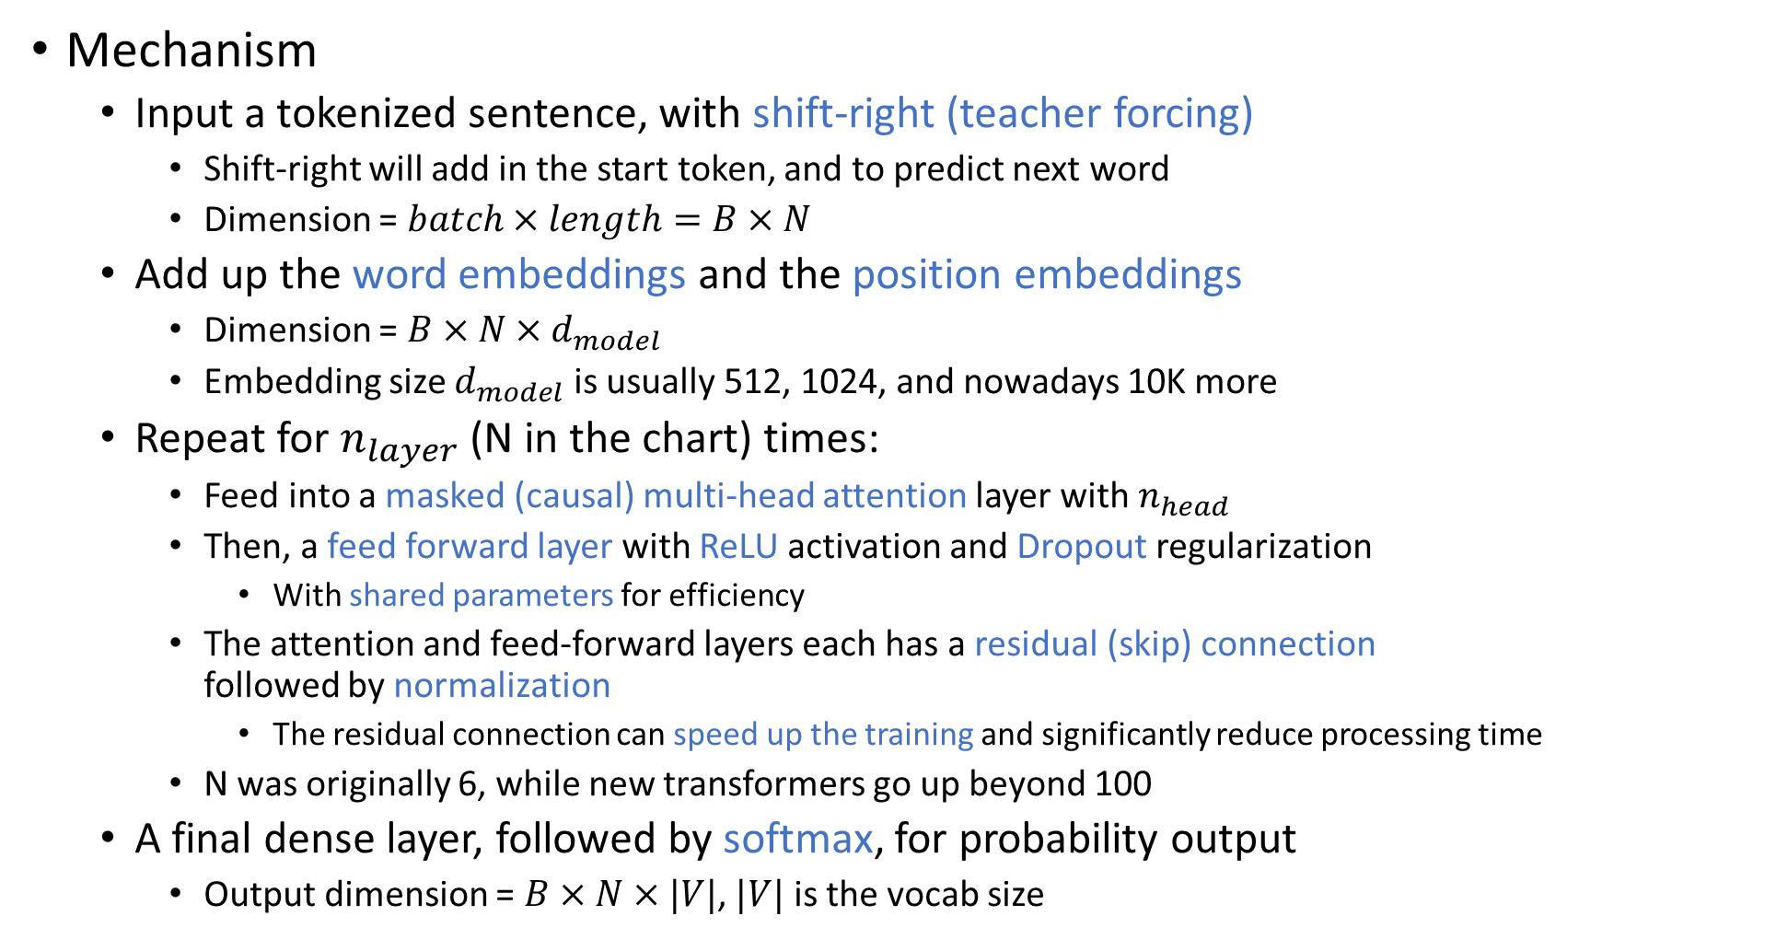
Transformer Decoder – GPT-2
Mechanism
Input a tokenized sentence, with shift-right (teacher forcing)
Shift-right will add in the start token, and to predict next word
Dimension = $batch×length=B×N$
Add up the word embeddings and the position embeddings
Dimension = $B×N×d_{model}$
Embedding size $d_{model}$ is usually 512, 1024, and nowadays 10K more
Repeat for $n_{layer}$ (N in the chart) times:
Feed into a masked (causal) multi-head attention layer with $n_{head}$
Then, a feed forward layer with ReLU activation and Dropout regularization
With shared parameters for efficiency
The attention and feed-forward layers each has a residual (skip) connection followed by normalization
The residual connection can speed up the training and significantly reduce processing time
N was originally 6, while new transformers go up beyond 100
A final dense layer, followed by softmax, for probability output
Output dimension = $B×N×|V|$, $|V|$ is the vocab size

Slide 10
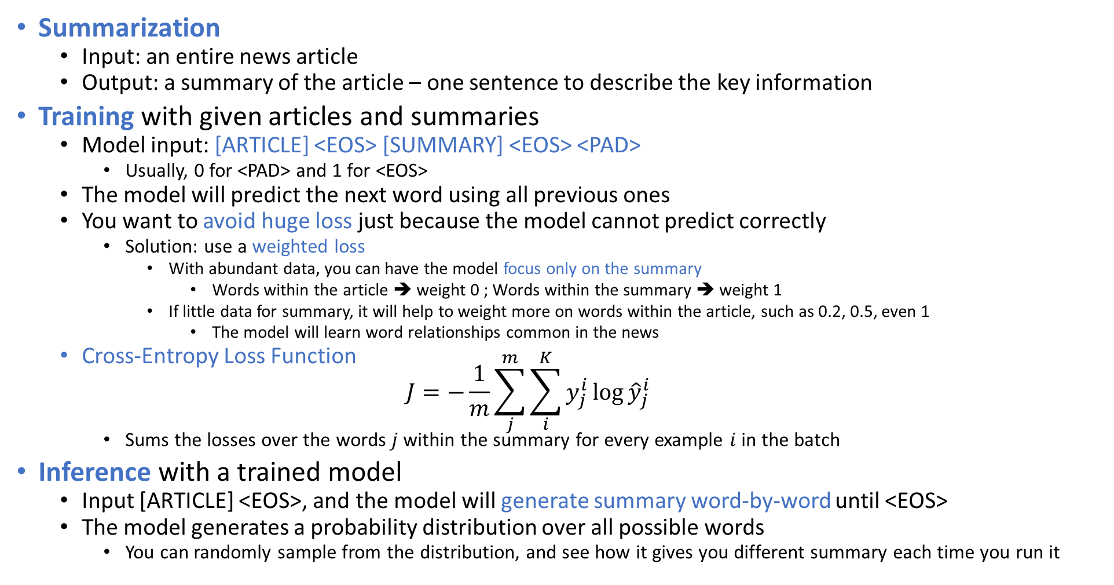
Transformer Summarizer
Summarization
Input: an entire news article
Output: a summary of the article – one sentence to describe the key information
Training with given articles and summaries
Model input: [ARTICLE] <EOS> [SUMMARY] <EOS> <PAD>
Usually, 0 for <PAD> and 1 for <EOS>
The model will predict the next word using all previous ones
You want to avoid huge loss just because the model cannot predict correctly
Solution: use a weighted loss
With abundant data, you can have the model focus only on the summary
Words within the article ➔ weight 0 ; Words within the summary ➔ weight 1
If little data for summary, it will help to weight more on words within the article, such as 0.2, 0.5, even 1
The model will learn word relationships common in the news
Cross-Entropy Loss Function $J=−\frac{1}{m}\sum_{j}^{m}{\sum_{i}^{K}{y_{j}^{i}\log{{\hat{y}}_{j}^{i}}}}$
Sums the losses over the words $j$ within the summary for every example $i$ in the batch
Inference with a trained model
Input [ARTICLE] <EOS>, and the model will generate summary word-by-word until <EOS>
The model generates a probability distribution over all possible words
You can randomly sample from the distribution, and see how it gives you different summary each time you run it

